Slide 1
Google PageRank Algorithm
Arusyak Hakobyan
Vahan Melkonyan
Vahagn Khachatryan
American University of Armenia
Numerical Analysis
Fall 2017

Slide 2


Multinational technology company that specializes in Internet-related services and products

Slide 3

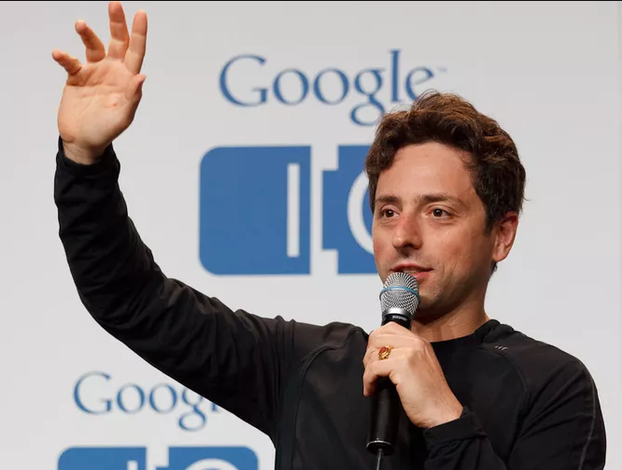
Larry Page
Sergey Brin

Slide 4
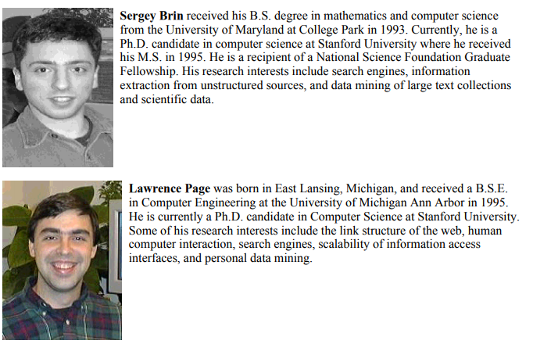
The Anatomy of a Large-Scale Hypertextual Web Search Engine (1998)

Slide 5
The Anatomy of a Large-Scale Hypertextual Web Search Engine (1998)
Problems
Scaling Up
Variety of the web
Text search
“Only one out of four web search giants being able to find themselves in the web.”
Commercial Interests

Slide 6
The PageRank Citation Ranking: Bringing Order to the Web (1999)
With Rajeev Motwani and Terry Winograd
Solutions
Link Structure
Crawling
Indexing
PageRank

Slide 7

1.
Probabilistic Approach
The fun starts now

Slide 8


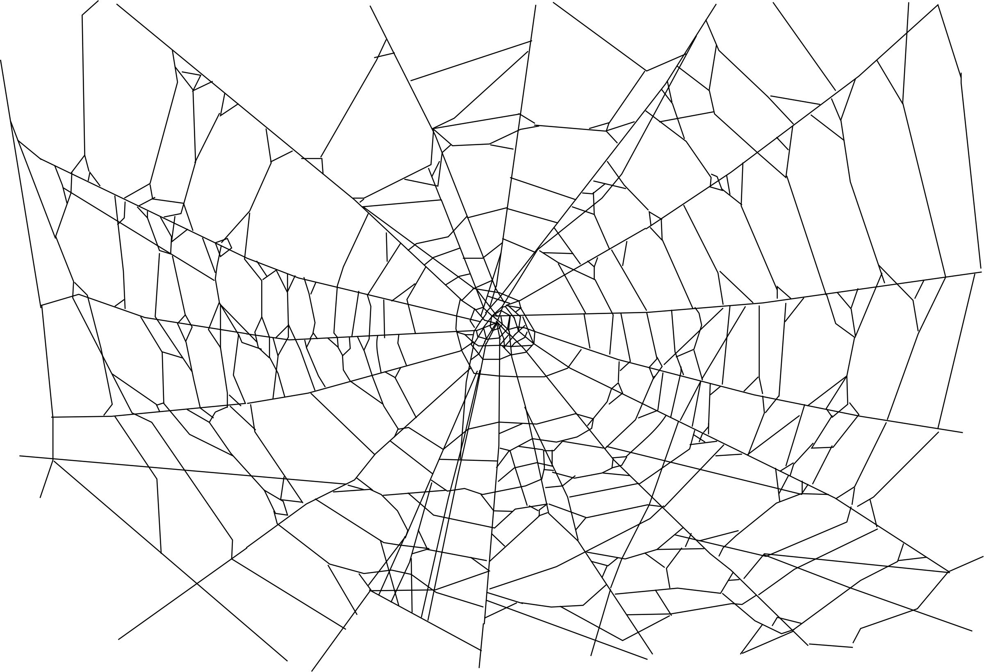
PR~obability
The Random Surfer Example
Surfs Randomly
Never back
Eventually gets bored
PageRank = Probability

Slide 9
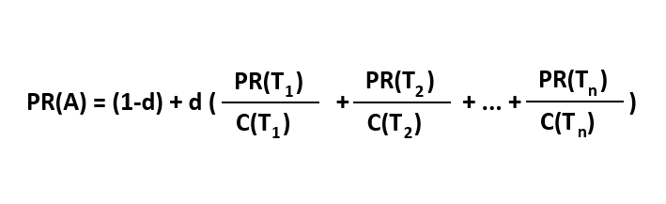
What Matters and What Doesn’t
PR’s of the Linking Pages ~ PR(Ti)
Total number of links each respective Linking Page possesses ~ C(Ti)
The d

Slide 10
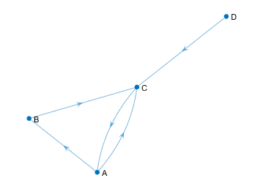
PageRank in Practice
Important to know:
Iterative Algorithm
Converges to 1
Let’s use our Intuition!

Slide 11
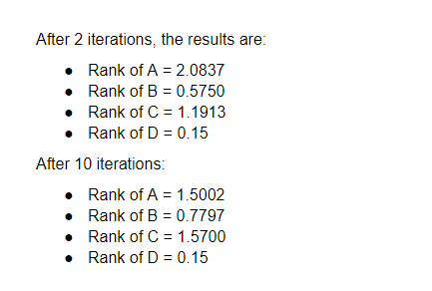
Results

Slide 12
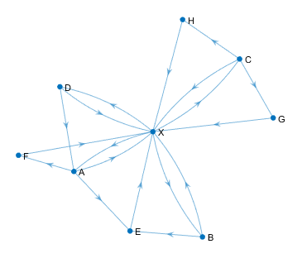
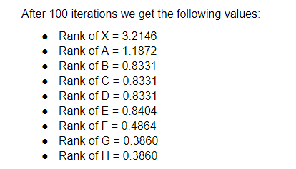

Web Tyrants or how to win in a game of Google?

Slide 13

SEO (Search-Engine Marketing)
Have a Landing Page (Home Page)
Get Linked
Get Linked BIG
How to get linked?
DO: Write good shareable linkable content, spend on Marketing!
DON’T: Use link farms, seriously, Google knows!

Slide 14

2.
Dynamical Systems
Let’s take a look at a simple example

Slide 15
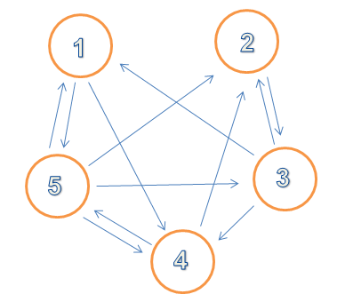
Step 1: Input
Let’s take n = 5 pages
page1 = [0 0 0 1 1];
page2 = [0 0 1 0 0];
page3 = [1 1 0 1 0];
page4 = [0 1 0 0 1];
page5 = [1 1 1 1 1];

Slide 16
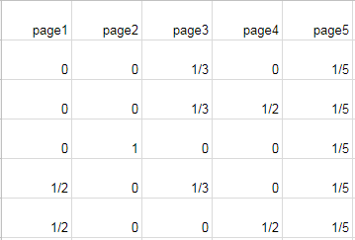
Step 2: Create Matrix A
page1 = [0 0 0 1 1];
page2 = [0 0 1 0 0];
page3 = [1 1 0 1 0];
page4 = [0 1 0 0 1];
page5 = [1 1 1 1 1];

Slide 17
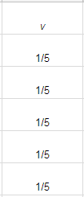
Step 2: Create Matrix v
v is our initial PageRank.
It will hold the current and final PageRank values.

Slide 18
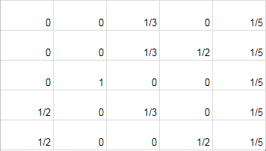
v = PageRank
A =

Slide 19
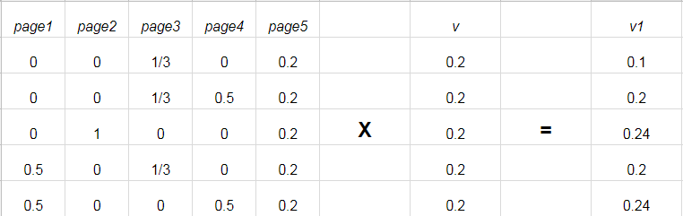
Step 3: Update the PageRank v
Do the following matrix multiplication
v₁ = A*v

Slide 20
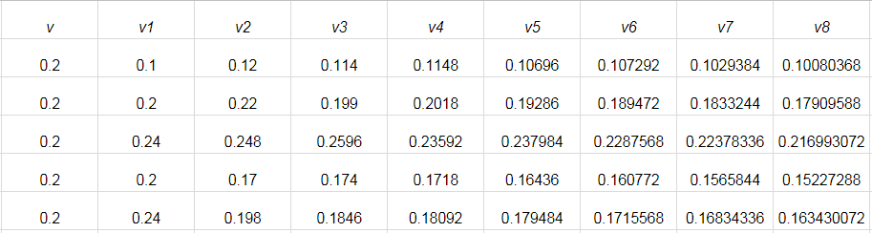
Step 3: Repeat k times
v_{k} = A^{k}v

Slide 21
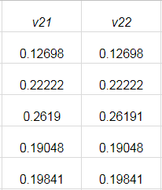
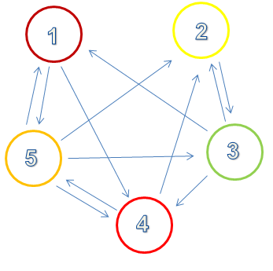
Step 4: Stop
After 22 iterations the results look very similar

Slide 22
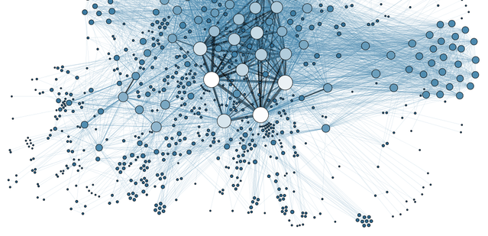
3.
Linear Algebra
Let’s analyze and optimize the algorithm

Slide 23
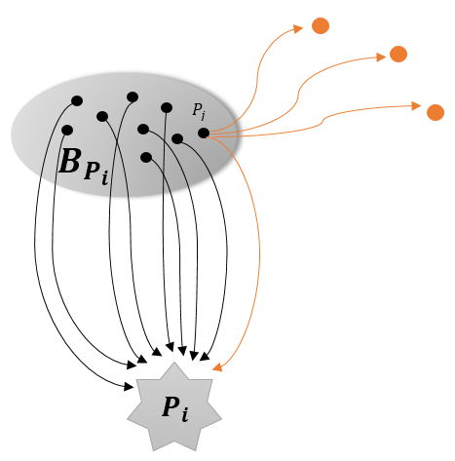
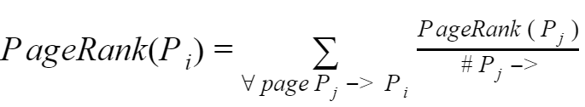
Initial PageRank Summation Formula

Slide 24
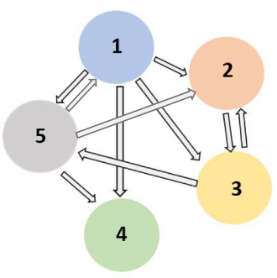
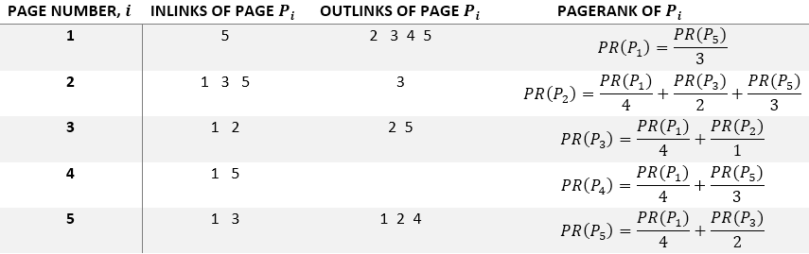
Example

Slide 25

Problem : PageRank(Pj)-s are unknown

Slide 26

Problem : PageRank(Pj)-s are unknown
Solution : Assume initially all pages have equal PageRank, say 1/n

Slide 27
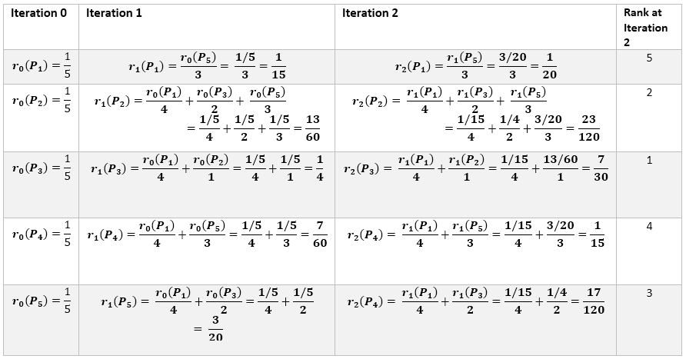

Slide 28


Slide 29

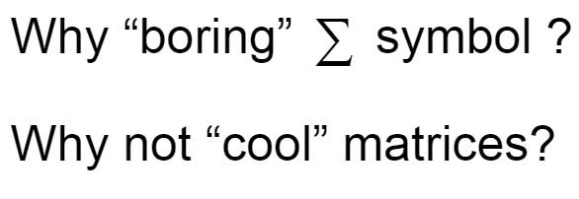

Slide 30
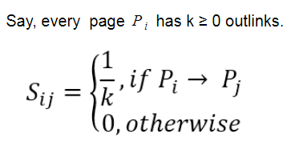
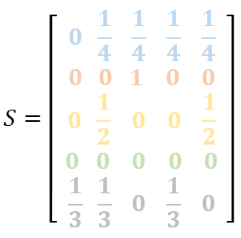
Matrix Representation

Slide 31
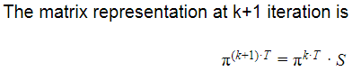
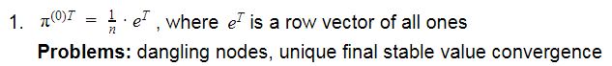
Initial Value

Slide 32
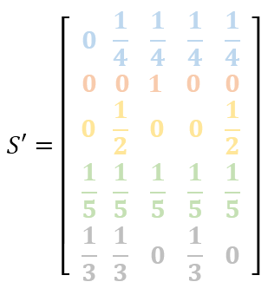
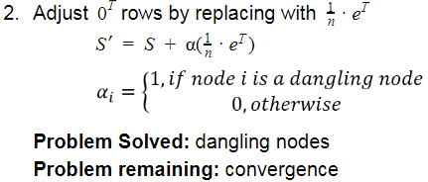
Initial Value

Slide 33

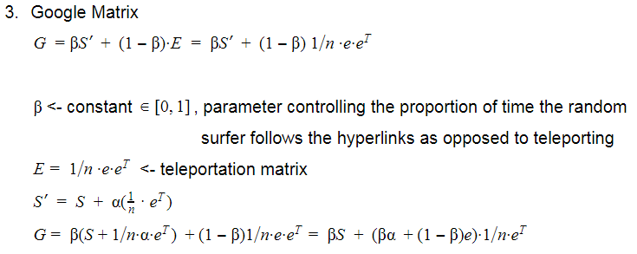
Matrix

Slide 34
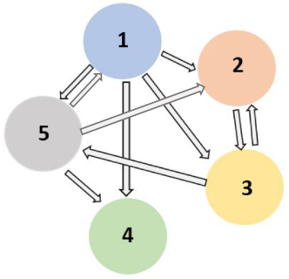
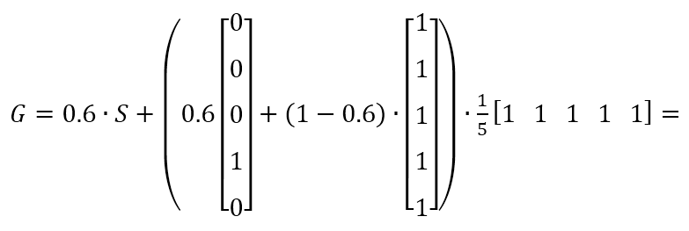

Slide 35
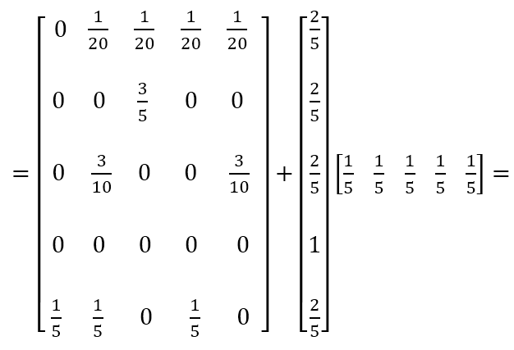

Slide 36
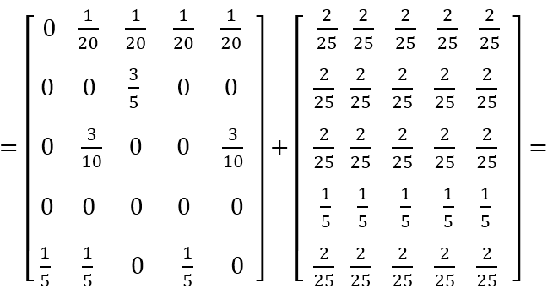

Slide 37
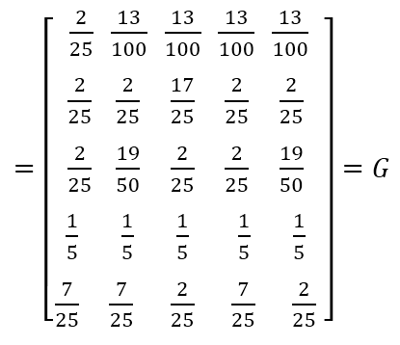

Slide 38
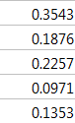

Slide 39

Thanks!
Any questions?

Slide 40
Bibliography and Credits
Presentation template by SlidesCarnival
Photographs by Unsplash and www.pixabay.com
Brin, S. and Page, L. (1998), The Anatomy of a Large-Scale Hypertextual Web Search Engine: http://ilpubs.stanford.edu:8090/361/ http://ilpubs.stanford.edu:8090/361/1/1998-8.pdf
Page, Lawrence and Brin, Sergey and Motwani, Rajeev and Winograd, Terry (1999), PageRank Citation Ranking: http://ilpubs.stanford.edu:8090/422/ http://ilpubs.stanford.edu:8090/422/1/1999-66.pdf
Ian Rogers, The Google Pagerank Algorithm and How It Works: http://www.cs.princeton.edu/~chazelle/courses/BIB/pagerank.htm
Amy N. Langville, Carl D. Meyer, Google’s PageRank and Beyond: The Science of Search Engine Rankings: http://geza.kzoo.edu/~erdi/patent/langvillebook.pdf

